Slide 1
NUMPY and PaNDAS
Week2

Slide 2
Python Dictionaries
Dictionaries are used to store data values in key:value pairs.
thisdict = {
"brand": "Ford",
"model": "Mustang",
"year": 1964
}
get item: x = thisdict["model"]
update item: thisdict["year"]="2000"
Add item: thisdict["color"] = "red"
Remove item: del thisdict["model"]
access item:
Reference:
for x in thisdict.values():
print(x)

Slide 3
Numpy Series
>>> d = {'a': 1, 'b': 2, 'c': 3}
>>> ser = pd.Series(data=d, index=['a', 'b', 'c'])
>>> ser
a 1
b 2
c 3
dtype: int64
The keys of the dictionary match with the Index values, hence the Index
values have no effect.
>>> d = {'a': 1, 'b': 2, 'c': 3}
>>> ser = pd.Series(data=d, index=['x', 'y', 'z'])
>>> ser
x NaN
y NaN
z NaN
dtype: float64

Slide 4
Reading data using pandas
In [ ]:
#Read csv file
df = pd.read_csv("http://rcs.bu.edu/examples/python/data_analysis/Salaries.csv")
Note: The above command has many optional arguments to fine-tune the data import process.
There is a number of pandas commands to read other data formats:
pd.read_excel('myfile.xlsx',sheet_name='Sheet1', index_col=None, na_values=['NA'])
pd.read_stata('myfile.dta')
pd.read_sas('myfile.sas7bdat')
pd.read_hdf('myfile.h5','df')

Slide 5
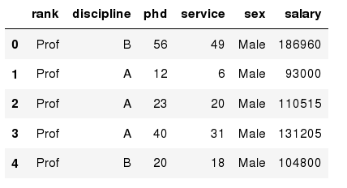
Exploring data frames
In [3]:
#List first 5 records
df.head()
Out[3]:

Slide 6
Data Frame data types
Pandas Type | Native Python Type | Description
object | string | The most general dtype. Will be assigned to your column if column has mixed types (numbers and strings).
int64 | int | Numeric characters. 64 refers to the memory allocated to hold this character.
float64 | float | Numeric characters with decimals. If a column contains numbers and NaNs(see below), pandas will default to float64, in case your missing value has a decimal.
datetime64, timedelta[ns] | N/A (but see the datetime module in Python’s standard library) | Values meant to hold time data. Look into these for time series experiments.

Slide 7
Data Frame data types
In [4]:
#Check a particular column type
df['salary'].dtype
Out[4]: dtype('int64')
In [5]:
#Check types for all the columns
df.dtypes
Out[4]:
object
object
int64
int64
object
int64
rank
discipline
phd
service
sex
salary
dtype: object

Slide 8
Data Frames attributes
Python objects have attributes and methods.
df.attribute | description
dtypes | list the types of the columns
columns | list the column names
axes | list the row labels and column names
ndim | number of dimensions
size | number of elements
shape | return a tuple representing the dimensionality
values | numpy representation of the data

Slide 9
Data Frames methods
Unlike attributes, python methods have parenthesis.
All attributes and methods can be listed with a dir() function: dir(df)
df.method() | description
head( [n] ), tail( [n] ) | first/last n rows
describe() | generate descriptive statistics (for numeric columns only)
max(), min() | return max/min values for all numeric columns
mean(), median() | return mean/median values for all numeric columns
std() | standard deviation
sample([n]) | returns a random sample of the data frame
dropna() | drop all the records with missing values

Slide 10
Selecting a column in a Data Frame
Method 1: Subset the data frame using column name:
df['sex']
Method 2: Use the column name as an attribute:
df.sex
Note: there is an attribute rank for pandas data frames, so to select a column with a name "rank" we should use method 1.

Slide 11
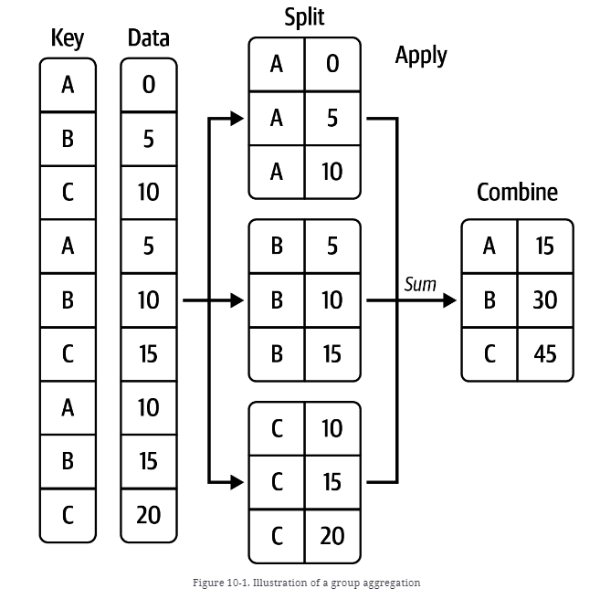
Group Aggregation
df.groupby([key])[[‘Data’]].sum()

Slide 12
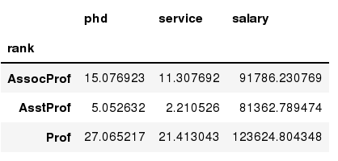
Data Frames groupby
Using "group by" method we can:
Split the data into groups based on some criteria
In [ ]:
#Group data using rank
df_rank = df.groupby(['rank'])
In [ ]:
#Calculate mean value for each numeric column per each group
df_rank.mean()

Slide 13
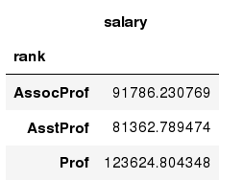
Data Frames groupby method
Once groupby object is create we can calculate various statistics for each group:
In [ ]:
#Calculate mean salary for each professor rank:
df.groupby('rank')[['salary']].mean()
Note: If single brackets are used to specify the column (e.g. salary), then the output is Pandas Series object. When double brackets are used the output is a Data Frame

Slide 14
Data Frames groupby method
groupby performance notes:
- no grouping/splitting occurs until it's needed. Creating the groupby object only verifies that you have passed a valid mapping
- by default the group keys are sorted during the groupby operation. You may want to pass sort=False for potential speedup:
In [ ]:
#Calculate mean salary for each professor rank:
df.groupby(['rank'], sort=False)[['salary']].mean()

Slide 15
Group Aggregation Example
https://pandas.pydata.org/docs/reference/api/pandas.DataFrame.groupby.html#

Slide 16
Data Frame: filtering
To subset the data we can apply Boolean indexing. This indexing is commonly known as a filter. For example if we want to subset the rows in which the salary value is greater than $120K:
In [ ]:
#Calculate mean salary for each professor rank:
df_sub = df[ df['salary'] > 120000 ]
Any Boolean operator can be used to subset the data:
> greater; >= greater or equal;
< less; <= less or equal;
== equal; != not equal;
In [ ]:
#Select only those rows that contain female professors:
df_f = df[ df['sex'] == 'Female' ]

Slide 17
Data Frames: Slicing
There are a number of ways to subset the Data Frame:
one or more columns
one or more rows
a subset of rows and columns
Rows and columns can be selected by their position or label

Slide 18
Data Frames: Slicing
When selecting one column, it is possible to use single set of brackets, but the resulting object will be a Series (not a DataFrame):
In [ ]:
#Select column salary:
df['salary']
When we need to select more than one column and/or make the output to be a DataFrame, we should use double brackets:
In [ ]:
#Select column salary:
df[['rank','salary']]

Slide 19
Data Frames: Selecting rows
If we need to select a range of rows, we can specify the range using ":"
In [ ]:
#Select rows by their position:
df[10:20]
Notice that the first row has a position 0, and the last value in the range is omitted:
So for 0:10 range the first 10 rows are returned with the positions starting with 0 and ending with 9

Slide 20
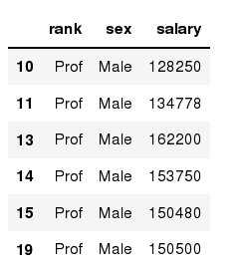
Data Frames: method loc
If we need to select a range of rows, using their labels we can use method loc:
In [ ]:
#Select rows by their labels:
df_sub.loc[10:20,['rank','sex','salary']]
Out[ ]:

Slide 21
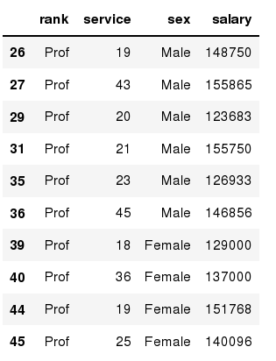
Data Frames: method iloc
If we need to select a range of rows and/or columns, using their positions we can use method iloc:
In [ ]:
#Select rows by their labels:
df_sub.iloc[10:20,[0, 3, 4, 5]]
Out[ ]:

Slide 22
Data Frames: method iloc (summary)
df.iloc[0] # First row of a data frame
df.iloc[i] #(i+1)th row
df.iloc[-1] # Last row
df.iloc[:, 0] # First column
df.iloc[:, -1] # Last column
df.iloc[0:7] #First 7 rows
df.iloc[:, 0:2] #First 2 columns
df.iloc[1:3, 0:2] #Second through third rows and first 2 columns
df.iloc[[0,5], [1,3]] #1st and 6th rows and 2nd and 4th columns

Slide 23
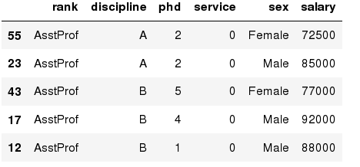
Data Frames: Sorting
We can sort the data by a value in the column. By default the sorting will occur in ascending order and a new data frame is return.
In [ ]:
# Create a new data frame from the original sorted by the column Salary
df_sorted = df.sort_values( by ='service')
df_sorted.head()
Out[ ]:

Slide 24
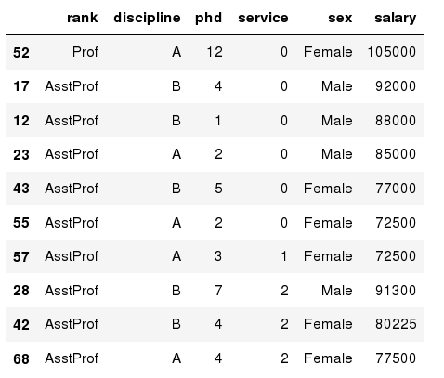
Data Frames: Sorting
We can sort the data using 2 or more columns:
In [ ]:
df_sorted = df.sort_values( by =['service', 'salary'], ascending = [True, False])
df_sorted.head(10)
Out[ ]:

Slide 25
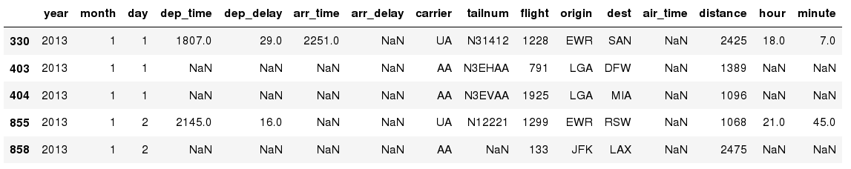
Missing Values
Missing values are marked as NaN
In [ ]:
# Read a dataset with missing values
flights = pd.read_csv("http://rcs.bu.edu/examples/python/data_analysis/flights.csv")
In [ ]:
# Select the rows that have at least one missing value
flights[flights.isnull().any(axis=1)].head()
Out[ ]:

Slide 26
Missing Values
There are a number of methods to deal with missing values in the data frame:
df.method() | description
dropna() | Drop missing observations
dropna(how='all') | Drop observations where all cells is NA
dropna(axis=1, how='all') | Drop column if all the values are missing
dropna(thresh = 5) | Drop rows that contain less than 5 non-missing values
fillna(0) | Replace missing values with zeros
isnull() | returns True if the value is missing
notnull() | Returns True for non-missing values

Slide 27
Missing Values
When summing the data, missing values will be treated as zero
If all values are missing, the sum will be equal to NaN
cumsum() and cumprod() methods ignore missing values but preserve them in the resulting arrays
Missing values in GroupBy method are excluded
Many descriptive statistics methods have skipna option to control if missing data should be excluded . This value is set to True by default

Slide 28
Aggregation Functions in Pandas
Aggregation - computing a summary statistic about each group, i.e.
compute group sums or means
compute group sizes/counts
Common aggregation functions:
min, max
count, sum, prod
mean, median, mode, mad
std, var

Slide 29
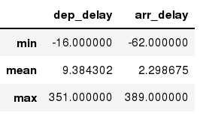
Aggregation Functions in Pandas
agg() method are useful when multiple statistics are computed per column:
In [ ]:
flights[['dep_delay','arr_delay']].agg(['min','mean','max'])
Out[ ]:

Slide 30
Basic Descriptive Statistics
df.method() | description
describe | Basic statistics (count, mean, std, min, quantiles, max)
min, max | Minimum and maximum values
mean, median, mode | Arithmetic average, median and mode
var, std | Variance and standard deviation
sem | Standard error of mean
skew | Sample skewness
kurt | kurtosis

Slide 31
Graphics to explore the data
Seaborn package is built on matplotlib but provides high level interface for drawing attractive statistical graphics, similar to ggplot2 library in R. It specifically targets statistical data visualization
To show graphs within Python notebook include inline directive:
In [ ]:
%matplotlib inline

Slide 32
Graphics
 | description
distplot | histogram
barplot | estimate of central tendency for a numeric variable
violinplot | similar to boxplot, also shows the probability density of the data
jointplot | Scatterplot
regplot | Regression plot
pairplot | Pairplot
boxplot | boxplot
swarmplot | categorical scatterplot
factorplot | General categorical plot

Slide 33
Basic statistical Analysis
statsmodel and scikit-learn - both have a number of function for statistical analysis
The first one is mostly used for regular analysis using R style formulas, while scikit-learn is more tailored for Machine Learning.
statsmodels:
linear regressions
ANOVA tests
hypothesis testings
many more ...
scikit-learn:
kmeans
support vector machines
random forests
many more ...
See examples in the Tutorial Notebook

Slide 34
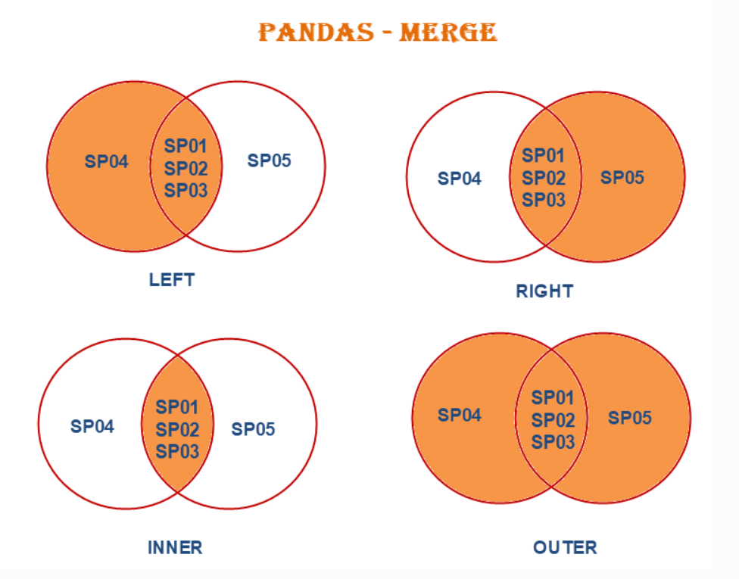
Pandas Merge

Slide 35
Merge Example
Example by https://pandas.pydata.org/docs/reference/api/pandas.DataFrame.merge.html

Slide 36
References
Book: McKinney, Wes. Python for data analysis" O'Reilly Media, Inc.", 2022.
https://learning.oreilly.com/library/view/python-for-data/9781098104023/ch10.html#groupby_mech_iteration

